Slide 1
Network and Cyber Security-I (CY2001) (Lecture 7 and 8)
Dr. Qaisar Shafi
Department of Computer Science,
National University of Computer & Emerging Sciences, Islamabad Campus

Slide 2
(Block Ciphers & Data Encryption Standard)

Slide 3
Computational Hardness
Let’s imagine that you have encrypted an important file a year ago and then forgot the key.
You just remember that you probably used 6 letters from english alphabets, may be some of them were capital ones, digits were also possible, and your security rules required at least one special symbol.
How many possible combinations are there?
3
Notes:
All the possible password symbols are 26 alphabet letters, plus 26 capital letters, plus 10 digits, plus 33 special symbols. A total of 95 “printable” symbols in total.
95⁶= 735,091,890,625

Slide 4
Computational Hardness
To Brute Force a key that provides 1024-bits of security, Combinations to try = 2¹⁰²⁴ ~ 2¹⁰⁰⁰
Suppose
A computer runs 10²⁰ instructions per second
There are 10²⁰ computers in this world
Now you can process 10⁴⁰ instructions/ second
In one year you can process 10⁴⁰ * 60 * 60 * 24 * 365 instructions
Once again over estimate 10⁴⁰ * 10²*10² * 10²* 10³ i.e. 10⁵⁰ approx.
10⁵⁰ is approximately 2²⁰⁰
So you need 2¹⁰⁰⁰/ 2²⁰⁰ = 2⁸⁰⁰ years.
Notes:
It is theoretically possible to break such a system but it is infeasible to do so by any practical means
Computationally hard problems or intractable problems, take an unreasonable amount of time to solve, even if given all available resources
Exa scale 10^18 not yet manufactured,
Currently Peta scale 10^15 Time/ Space Complexity
Ghz -10 power 9
Even if ridiculous amount of weaknesses found = 2^{10 years} = 1024 years
NSA declassifies after 25 years

Slide 5
Modern (Digital) Cryptography
With the advent of digital computers, research and development into methods of digital cryptography started (in the 70’s)
Modern digital ciphers operate on binary (plaintext) data using a binary key to generate binary ciphertext
There are two general types of modern digital ciphers:
Block ciphers (e.g., DES, KASUMI and Rijndael)
Stream ciphers (e.g., RC4, A5 and E0)

Slide 6
Block Cipher
A block cipher is an encry/decry scheme in which a block of plaintext is treated as a whole and used to produce a ciphertext block of equal length.
Block ciphers have a Fiestel structure. Such a structure consists of a number of identical rounds of processing. In each round , a substitution is performed on one half of the data being processed , followed by a permutation that interchange the two halves.
The original key is expanded so that a different key is used for each round.

Slide 7
Block Ciphers
Let P denote the set of all possible plaintext symbols, C denote the set of all possible ciphertext symbols, and K denote the set of all possible keys (the keyspace)
A symmetric-key block cipher E is a function:
E : P x K -> C
Moreover, for every key k in K , we have invertible functions
E_{K} : P -> C
D_{K} : C-> P
and D_{K} = E_{K}⁻¹.
In other words, the key determines the bijective mapping of plaintext to ciphertext and also determines the inverse mapping of ciphertext to plaintext

Slide 8
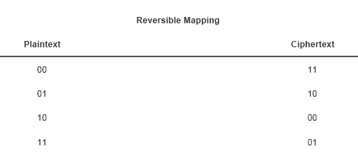
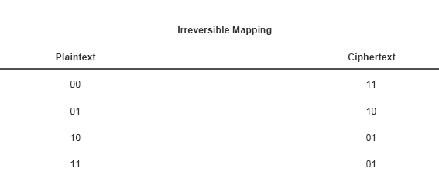
Block Cipher Principles
A block cipher operated on a plaintext block of n bits to produce a ciphertext block of n bits.
There are 2^{n} possible different plaintext blocks and for the encryption to be reversible , each must produce a unique ciphertext block, called reversible or non-singular.

Slide 9
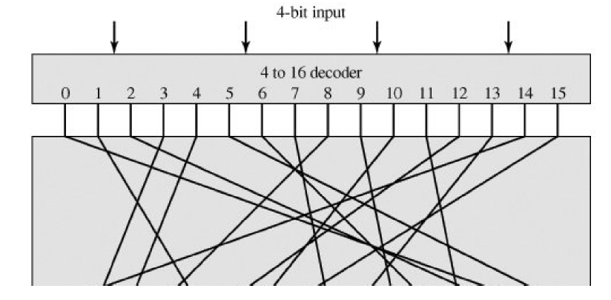
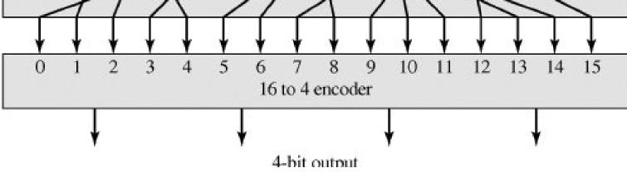
Block Cipher Principles

Slide 10
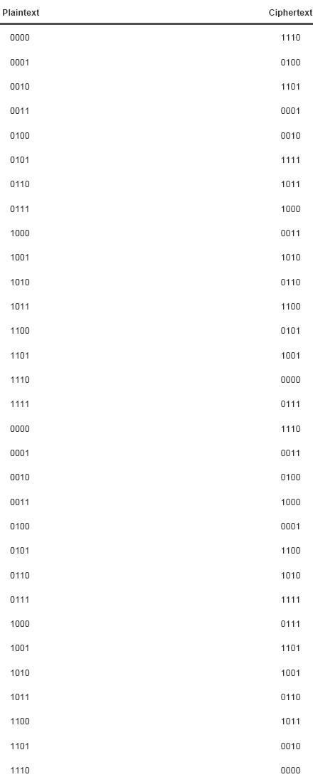
Block Ciphers Principles

Slide 11
Block and Key Size/Length
If the key is fixed, and hence determines a specific mapping, the block cipher can be considered simply as a large lookup-table (substitution cipher)
In particular, identical plaintext blocks encrypt to identical ciphertext blocks
Since modern ciphers are implemented on digital systems, it is common to measure block sizes in bits
We say that a block cipher has a block size (or block length) of m bits, which means that |P| = |C| = 2^{m}
Similarly We say that a block cipher has a key size (or key length) of k bits, which means that |K| = 2^{k}

Slide 12
Block Ciphers: Problems
Reversible is Known as ideal block cipher.
Problem, if a small block size such as n=4 is used , system is equivalent to classical substitution cipher, vulnerable to statistical analysis of plaintext, then cryptanalyst can attempt to recover the plaintext from the ciphertext by frequency analysis
This weakness is not inherent in the use of substitution cipher but rather result from small block size.

Slide 13
Block Ciphers: Problems
Another problem is that if an attacker correctly guesses the plaintext that corresponds to some ciphertext then he can build a lookup-table of plaintext-ciphertext pairs corresponding to a particular key, known as a codebook
Codebooks can be used to decrypt ciphertext blocks without knowledge of the key

Slide 14
Block Ciphers: The solution
Both problems are solved by increasing the block length, and thus increasing the number of possible messages. If n is sufficiently large, and an arbitrary reversible substitiution between plaintext and ciphertext is allowed , then statistical analysis is infeasible.
It also becomes impractical for an attacker to build plaintext-ciphertext codebooks
Typically the message block length m would be at least 64 bits (2⁶⁴ = 18446744073709551616)

Slide 15
Example: Block Cipher Encryption
Key k
Plaintext
Padding
p₀
p₁
p₂
p₃
p₄
p₅
F
F
F
F
F
F
c₀
c₁
c₂
c₃
c₄
c₅

Slide 16
A simple block cipher
Except for small message block or key lengths, it is infeasible for the block cipher designer to explicitly specify a plaintext to ciphertext mapping for every possible key: this would be like specifying 2^{k} codebooks
It is far more practical to specify the block cipher as an equation or an algorithm
So for example, a simple block cipher with parameters (m,k) = (64,64) might be specified by:
C = P K
P = C K

Slide 17
Another simple block cipher
The problem with the previous simple block cipher is that it is trivially broken with one known plaintext by K = P C
This block cipher is weak because it is purely linear and thus easily solvable
By using both linear and nonlinear operations we make the block cipher somewhat more difficult to manipulate by simple algebra
So for example, a slightly better idea would be the (m,k) = (64,128) block cipher:
C = (P K₀) + K₁
P = (C – K₁) K₀
where K₀ and K₁ are key-dependent variables called subkeys
In this case, each subkey is half of the key K, and thus has length 64 bits

Slide 18
Another simple block cipher (2)
To recover the key K, an attacker would have to solve the cipher equation C = (P K₀) + K₁
Since there are two unknowns, a unique solution would not be found with only one known plaintext
However, with two known plaintexts, (P,C) and (P’,C’), we have the equations:
C = (P K₀) + K₁
C’ = (P’ K₀) + K₁
The attacker could subtract ,ciphertext from another, obtaining:
C – C’ = (P K₀) – (P’ K₀)
where the 64-bit subkey K₁ term has been eliminated
However, this equation cannot be manipulated further to an equation of the remaining subkey K₀ in terms of the plaintext and ciphertext blocks because the exclusive-or and integer addition do not follow the distributive law of algebra

Slide 19
Confusion and Diffusion
The mixture of linear and non-linear operations makes it difficult to express the key in terms of the plaintext and ciphertext blocks, thus preventing a simple known plaintext attack
The idea of mixing linear and nonlinear operations in order to obscure the relationship between the plaintext, ciphertext and key,is called confusion and is an important principle of cipher design
An equally important principle of block cipher design is that of diffusion, i.e., the idea that every bit of the ciphertext should depend on every bit of the plaintext and also every bit of the key
This ensures that the statistics of the plaintext are dissipated within the ciphertext so that an attacker cannot predict the plaintext that corresponds to a particular ciphertext, even after observing a number of “similar” plaintexts and their corresponding ciphertexts
Notes:
Confusion is an encryption operation where the relationship between key and ciphertext is obscured. Today, a common element for achieving confusion is substitution, which is found in both DES and AES.
Diffusion is an encryption operation where the influence of one plaintext symbol is spread over many ciphertext symbols with the goal of hiding statistical properties of the plaintext. A simple diffusion element is the bit permutation, which is used frequently within DES. AES uses the more advanced Mixcolumn operation.

Slide 20
Iterated ciphers
A simple method of achieving confusion and diffusion in a block cipher is by repeatedly applying keyed substitutions and permutations to the message
The substitutions are used to introduce nonlinearity into the message (confusion) and the permutations are required to ensure that bits are affected by different substitutions on subsequent iterations (diffusion)
A block cipher based on this principle is called an iterated cipher

Slide 21
Round function
In practice, the designer develops a function , known as the round function, which has inputs of a message block X and a subkey K, and outputs an encrypted message block Y = (X, K)
The round function is responsible for satisfying the basic confusion and diffusion requirements, hence we would want each bit of X and each bit of K to influence each bit of Y in a nonlinear but invertible manner
For example, the following round function fulfils the confusion requirement by mixing (nonlinear) integer addition with (linear) bitwise permutation, and the diffusion requirement by the bitwise permutation:
(X,K) = (X + K)  3
where  denotes bitwise rotation

Slide 22
Iterated ciphers
By iterating the round function a fixed number of times we automatically obtain some security as a consequence of the fact that, after each iteration (or round), the output bits become increasingly dependent on the input bits
We can use different subkeys in each iteration so that, for a 4-round block cipher, the encryption function becomes:
C = E(P,K) = ((((P,K₁),K₂),K₃),K₄)
Similarly, decryption would be achieved by:
P = D(C,K) = ^{–1}(^{–1}(^{–1}(^{–1}(C,K₄),K₃),K₂),K₁)
where, for a fixed K, ^{–1} is the inverse function of 

Slide 23
Example: Iterated Ciphers
Data (Plaintext)
Round
Function
Iterated Block Cipher
Subkey 1
Key
Schedule
Round
Function
Key
Subkey 2
…
Data (Ciphertext)

Slide 24
Summary: Iterated Ciphers
Most block ciphers are based on the design of a round function that is applied a fixed number of times (called rounds) to the data
The round function encrypts the data block using a subkey (or round key) that is derived from the key; each round uses a different subkey
The subkeys are generated from the key through an algorithm called the key schedule
A cipher that is comprised of multiple applications of the same round function is called an iterated cipher

Slide 25
SP-networks
A type of block cipher design called a substitution-permutation network, or simply SP-network, uses a round function that is composed of an invertible (nonlinear) substitution function followed by a invertible (linear) permutation function
The substitution function normally takes the key as an input in addition to the message (data) block
For example:
C = E(P,K) = (((((P,K₁),K₂),K₃),K₄))
P = D(C,K) = (((((C,K^{–1}₄),K^{–1}₃),K^{–1}₂),K^{–1}₁))
where (M,K) = ((M,K)) and ^{–1} =  and ^{–1} = 
A block cipher based on an SP-network ensures that both confusion and diffusion can eventually be achieved (i.e., after a sufficient number of rounds) by a series of successive substitutions and permutations

Slide 26
Example: SP-network
Data (Plaintext)
Round
Function
Subkey 1
Substitution
Round
Function
Subkey 2
Permutation
Round
Function
…
Data (Ciphertext)

Slide 27
Feistel Ciphers
A specific type of SP-network cipher design, called a Feistel cipher, splits the data block into two halves (e.g., 32-bits each for a 64-bit data block) and applies a substitution function and a permutation function to these half-blocks
Suppose the input to a round is a message block M which is divided into two halves M=(L,R)
The round function  is given by (M,K) = ((L,R),K) = (((L,R),K)) = ((M,K))
The substitution function  is given by ((L,R),K) = (L F(R,K),R)
It is easily verified that this is an involution
The function F is called the cipher function
The permutation function  is given by ((L,R)) = (R,L)
This performs a swapping of halves and is clearly an involution

Slide 28
Feistel Ciphers
L R K
Round function:
((L,R),K) = (((L,R),K))
Substitution (“cipher”):
((L,R),K) = (L F(R,K),R)
Permutation (“swap”):
((L,R)) = (R,L)
F
F

Slide 29
Example: Feistel Ciphers
Data (Plaintext)
Round
Function
Subkey 1
F
Round
Function
Subkey 2
Round
Function
…
Data (Ciphertext)

Slide 30
Example: A 5-round Feistel cipher
P_{L}
P_{R}
The plaintext is split into halves P_{L} and P_{R}
The ciphertext is output as the two halves
C_{L} and C_{R}
Note that there is no swap in the last round of a Feistel cipher. This is to ensure that the cipher is an involution – i.e., we don’t need
to design a separate cipher structure for decryption; to decrypt, the same cipher structure, including cipher function, is used
except that the round keys (subkeys) are
applied in the reverse order.
F
F
F
F
F
L_{n}=R_{n-1}
R_{n}=L_{n-1}+(R_{n-1} K_{n})
C_{L}
C_{R}
Notes:
NOTE: There is no swap in the final round. This is so that the cipher structure becomes an involution.

Slide 31
List of Feistel ciphers
Blowfish,
Camellia,
CAST-128,
FEAL,
ICE,
LOKI97,
Lucifer,
MARS,
MAGENTA,
MISTY1,
TEA,
Triple DES,
Twofish,
XTEA,
GOST_28147-89

Slide 32
“DATA ENCRYPTION STANDARD”

Slide 33
DES block cipher
Plaintext (64)
IP
Subkey 1 (48)
Key(64 bit)
F
Subkey 2...15 (48)
F
Subkey 16 (48)
F
IP⁻¹
Ciphertext (64)

Slide 34
END OF LECTURE

Slide 35
Any Questions ?

